Slide 1

Unsupervised Monocular Depth Estimation with Left-Right Consistency
Clément Godard¹ Oisin Mac Aodha² Gabriel J. Brostow¹
¹University College London ²Caltech

Slide 2
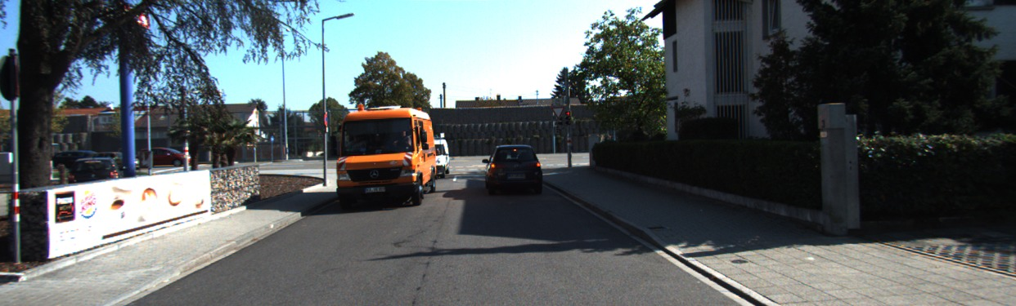
Input image

Slide 3
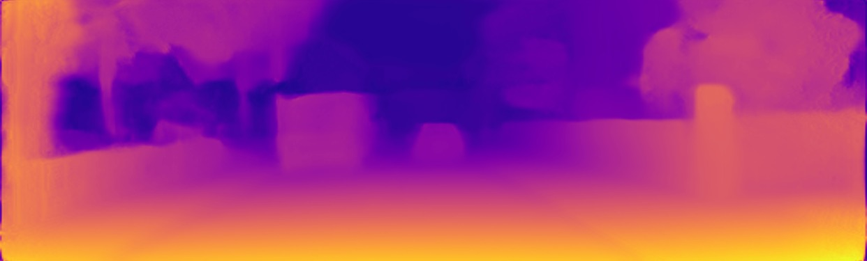
Our result

Slide 4
Why depth?

Slide 5
How do we usually get depth?

Slide 6

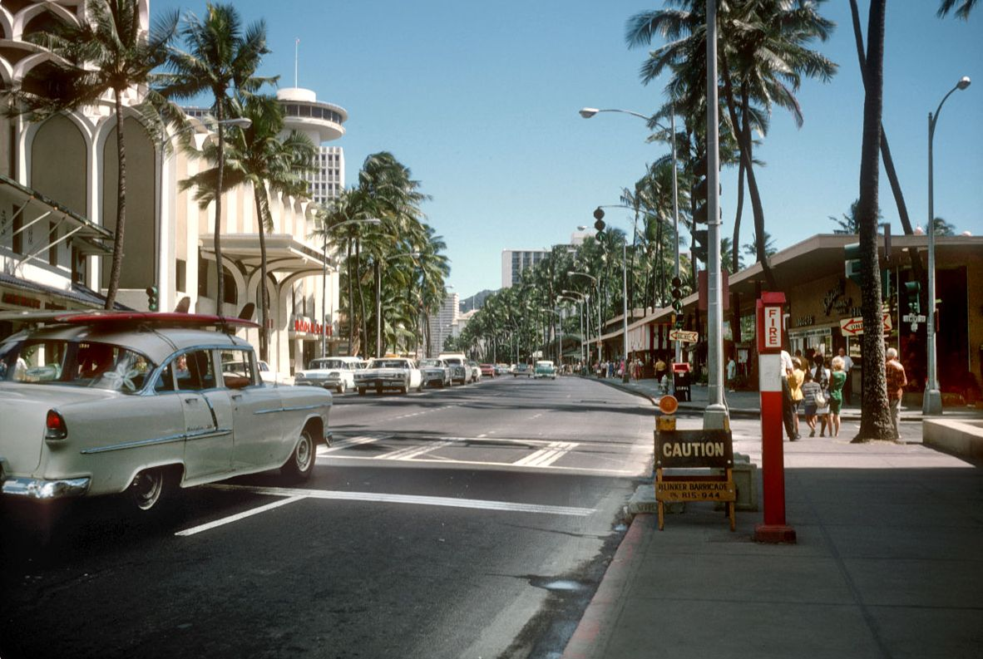
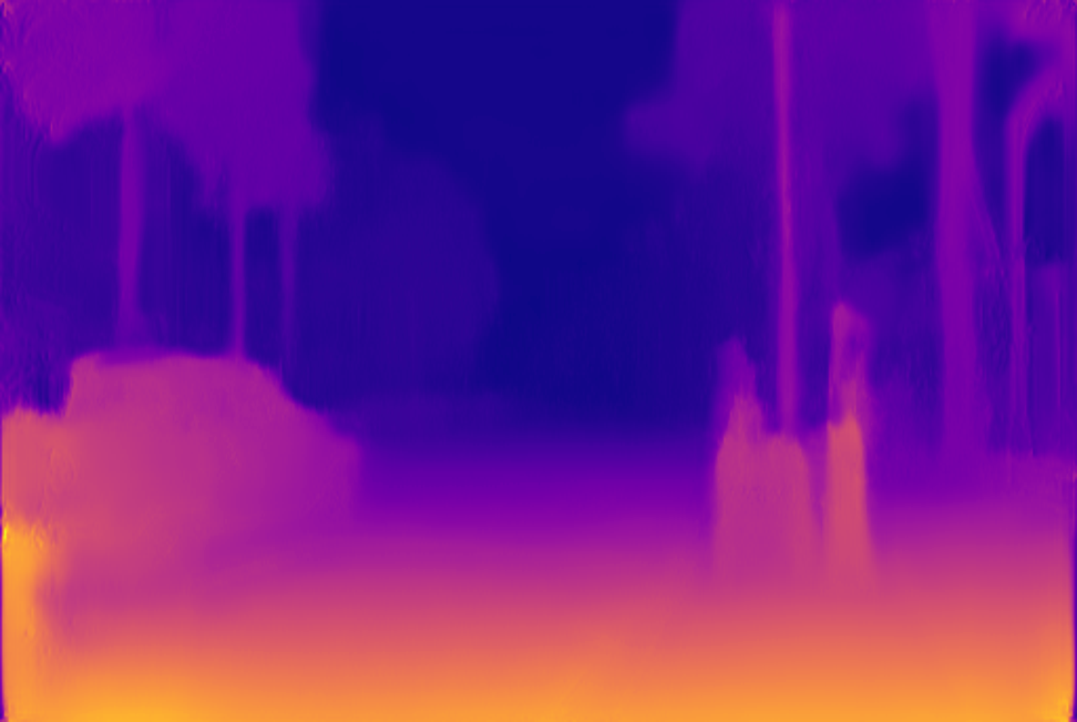
Why monocular?

Slide 7
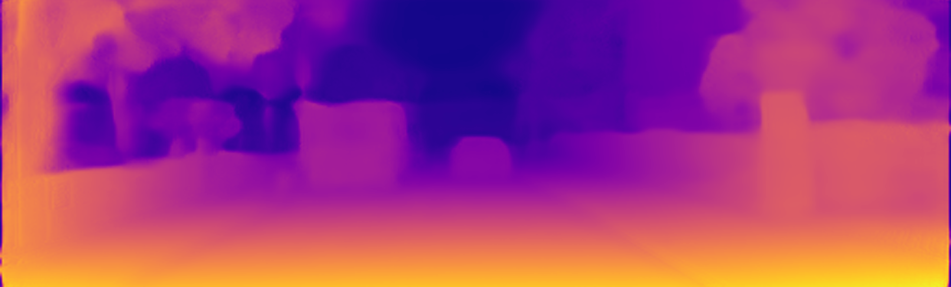
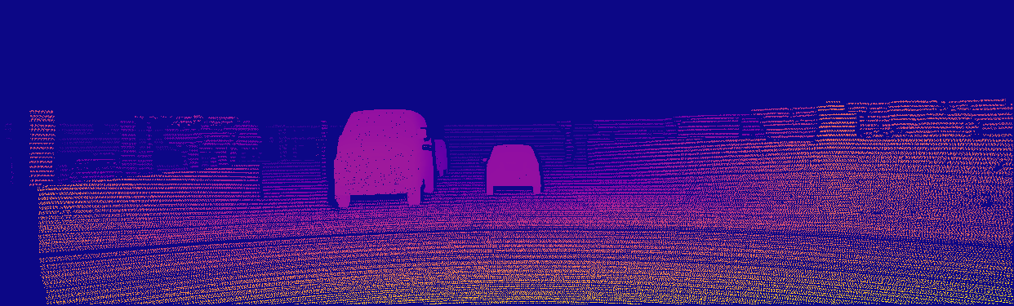
Previous approaches - Supervised
Loss
Input
color
Model
Output
depth
Target
depth

Slide 8
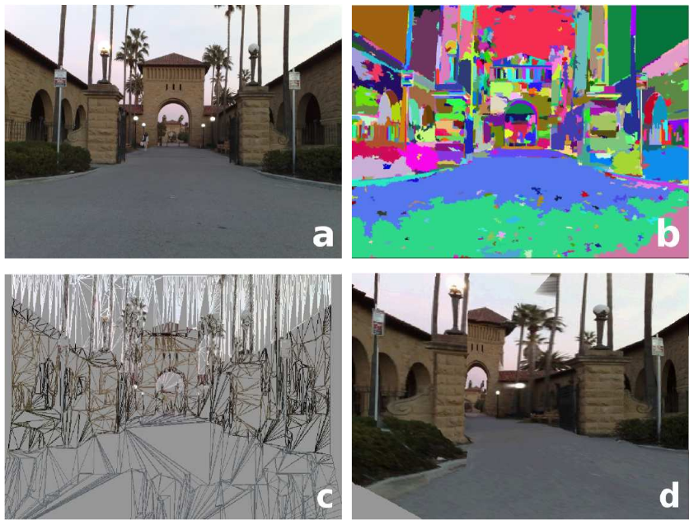
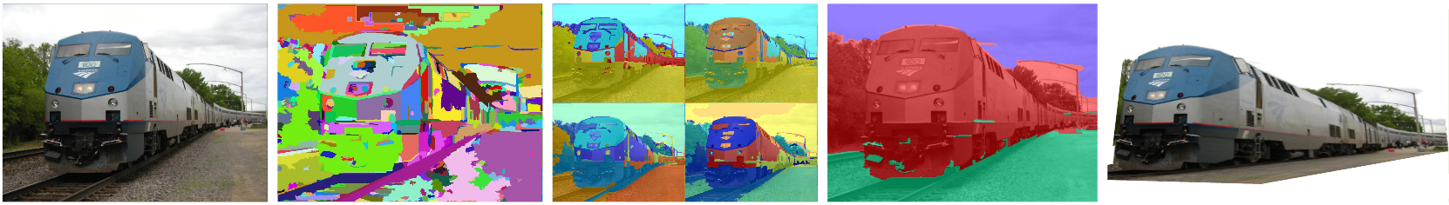
Previous approaches - Supervised
Make3D [PAMI 08]
Automatic Photo Pop-up [SIGGRAPH 05]

Slide 9
Previous approaches - Supervised
Loss
Input
Model
Output
depth
Target
depth

Slide 10
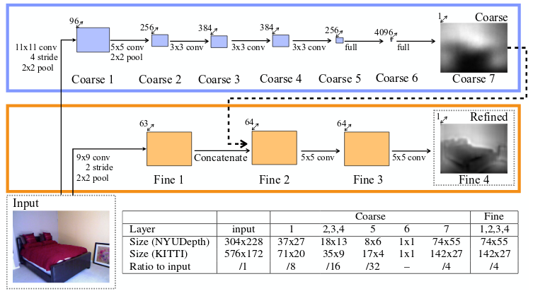
Previous approaches - Supervised
Loss
Input
CNN
Output
depth
Target
depth
Eigen et al. [NIPS 14]
Li et al., Laina et al., Cao et al., ...

Slide 12
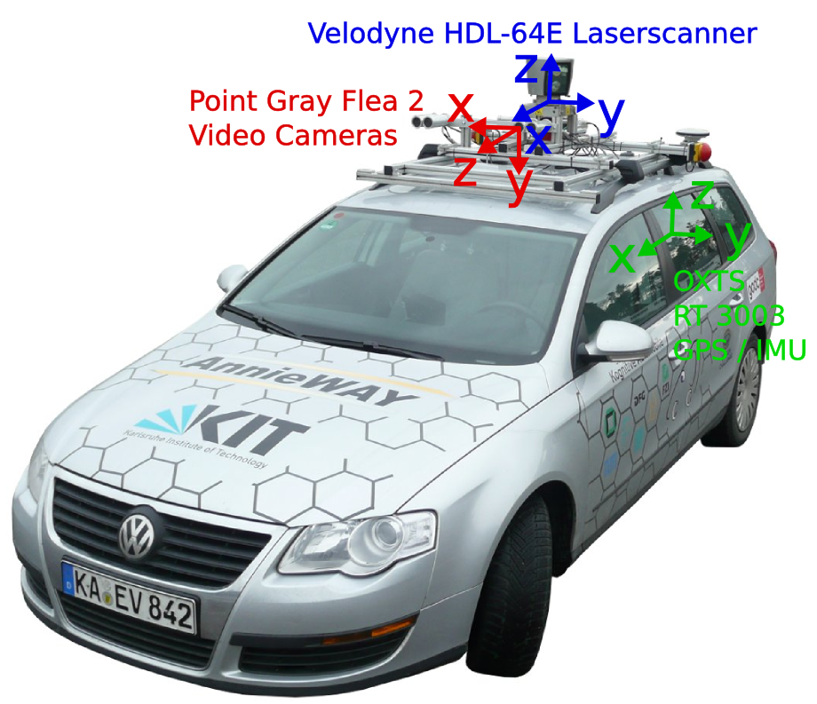
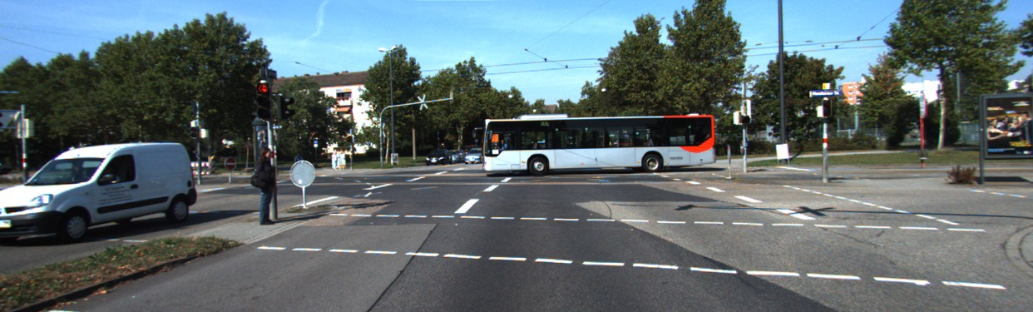
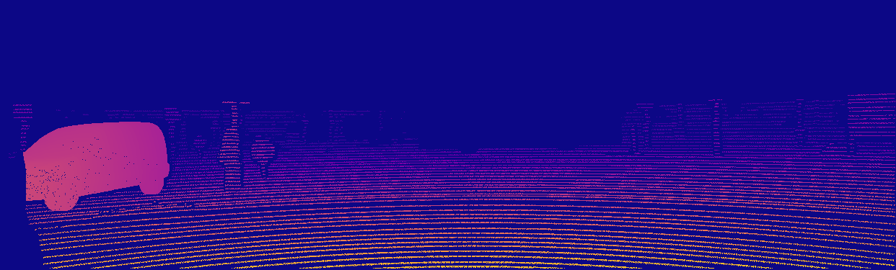
KITTI 2015

Slide 13
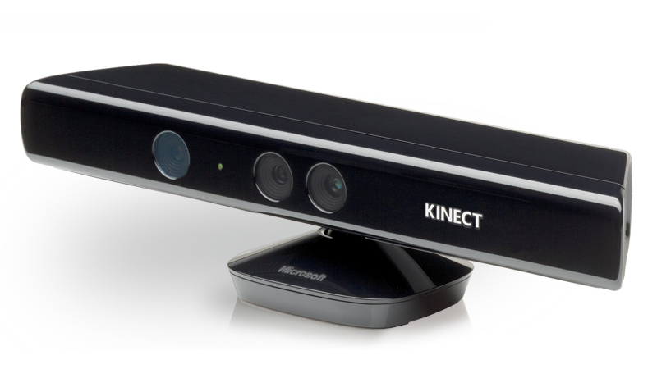
IR Structured Light
Does not work well outside

Slide 15

Depth from stereo
$$Disparity ∝ \frac{1}{Depth}$$
L
R

Slide 16
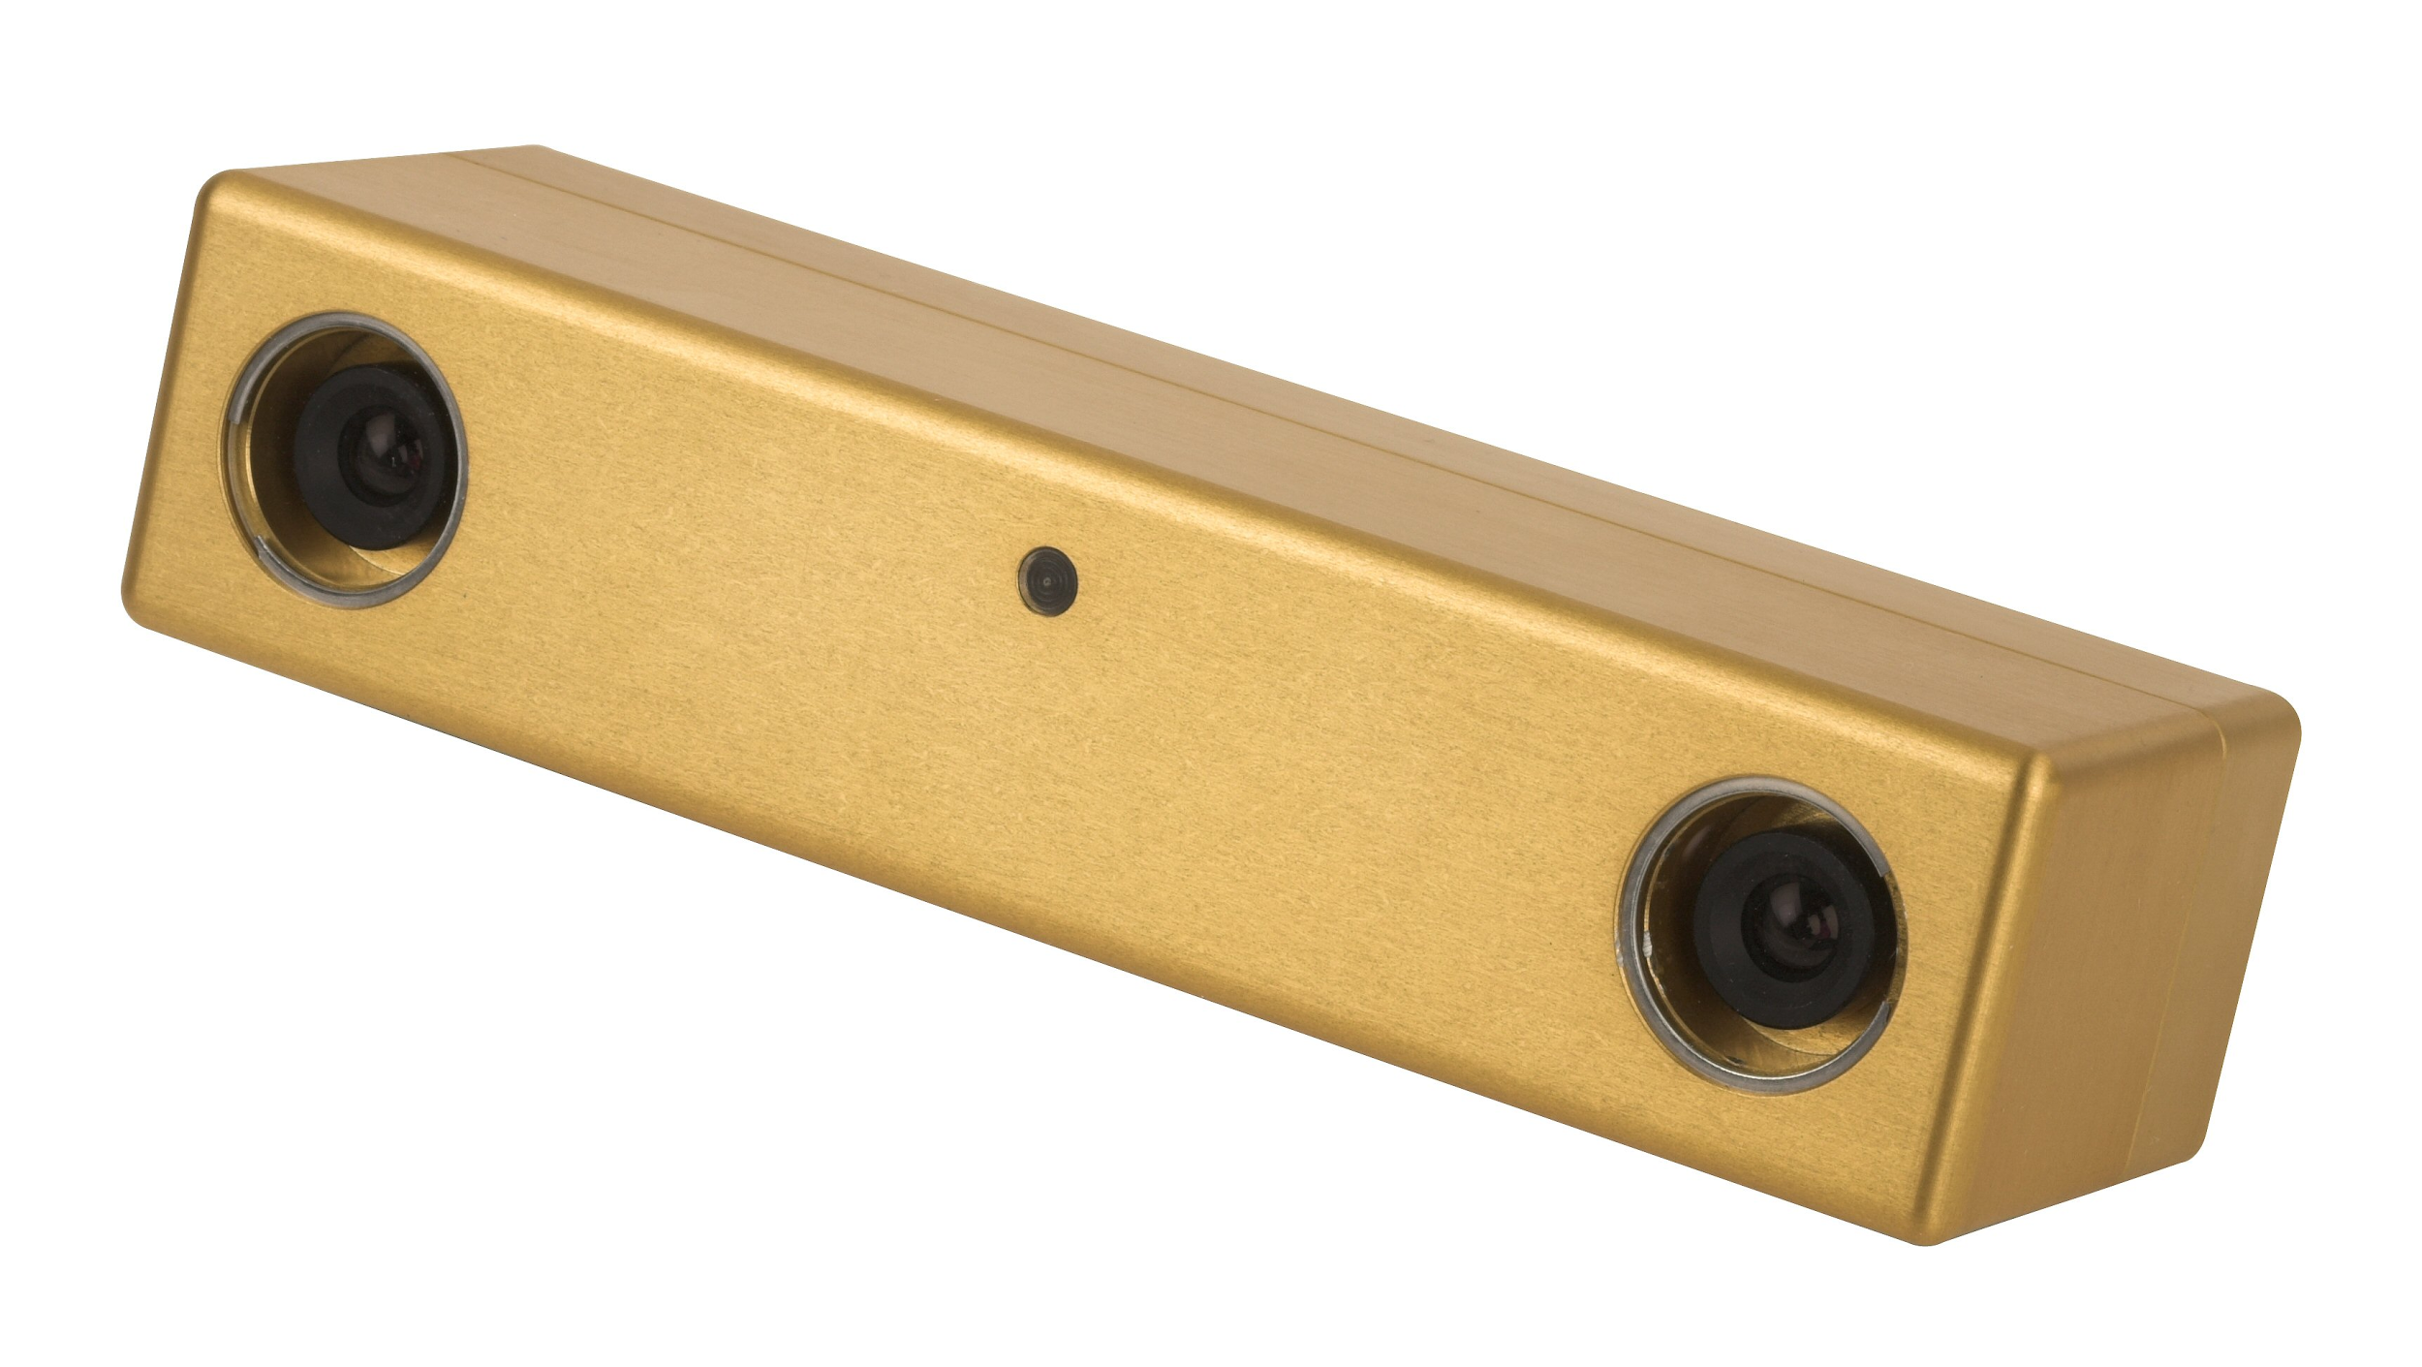
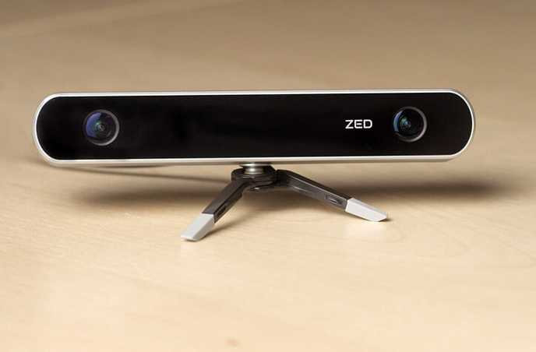
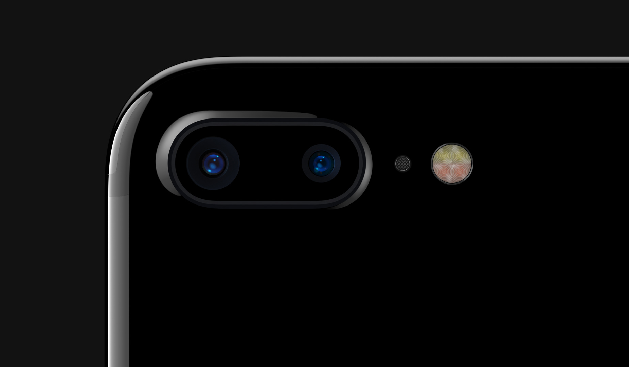
Let’s train with stereo data!
Point Grey
Apple
Stereolabs

Slide 17
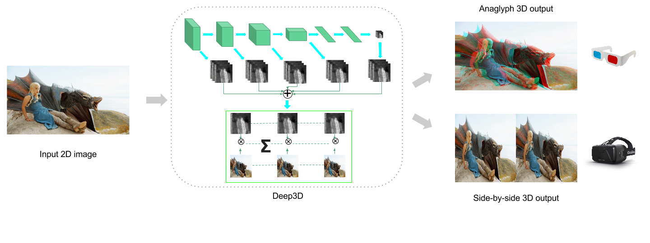
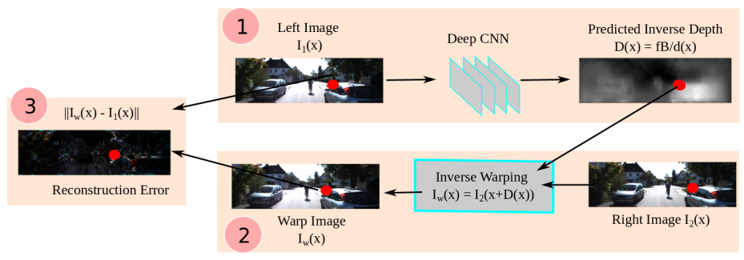
Previous approaches - Unsupervised
Deep3D
Xie et al. [ECCV 16]
Garg et al. [ECCV 16]

Slide 18
Unsupervised depth estimation - Concept
Loss
L
L
L
L
R
Input
colors
CNN
Output
disparity
Sampler
Output
color
Target
color

Slide 19
Unsupervised depth estimation - Baseline
Loss
L
L
L
L
R
Input
colors
CNN
Output
disparity
Sampler
Output
color
Target
color
Differentiable!
Spatial transformer networks, Jaderberg et al. [NIPS 15]

Slide 20
Input

Slide 21
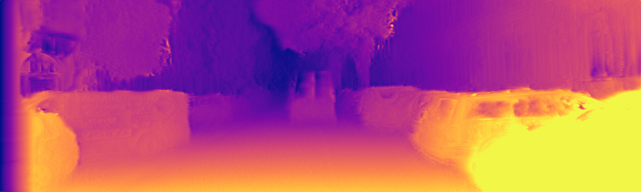
Baseline

Slide 22
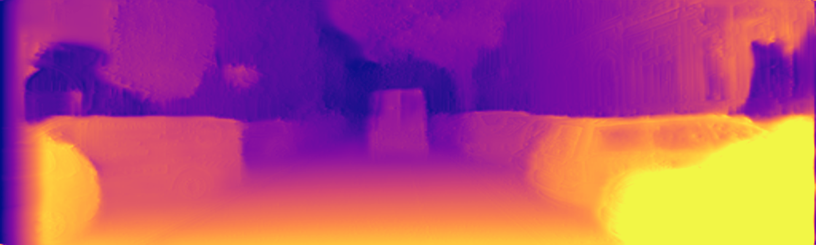
Our method

Slide 23
Unsupervised depth estimation - Our method
Smoothness Loss
LR Loss
Loss
R
R
R
L
L
L
L
R
Input
colors
CNN
Output
disparities
Sampler
Output
colors
Target
colors

Slide 24
Architecture
Skips
Fully convolutional
Choose your favorite encoder
Skip connections
Similar to DispNet and FlowNet
Multiscale generation
And Loss!
Fast!
~30fps on a Titan X
Encoder
Decoder
Outputs

Slide 25
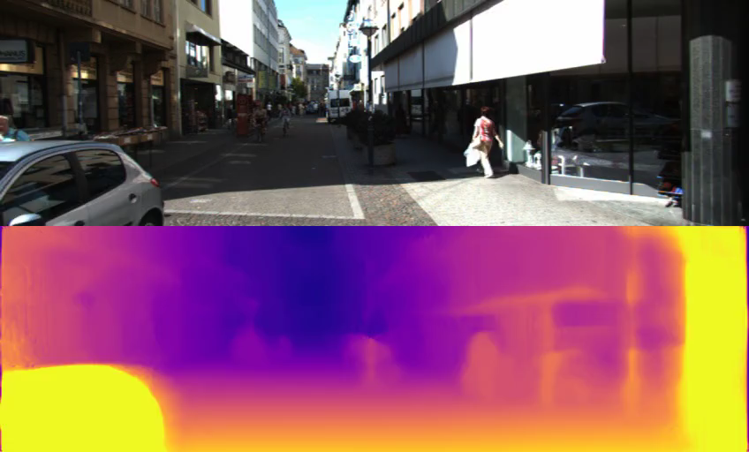

Slide 26
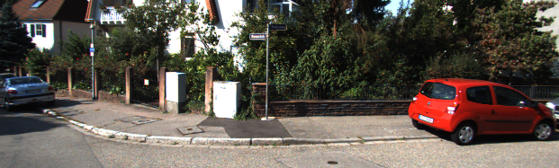
KITTI – Input image

Slide 27
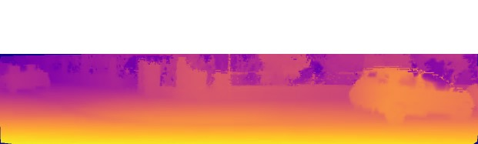
KITTI – Ground truth depth

Slide 28
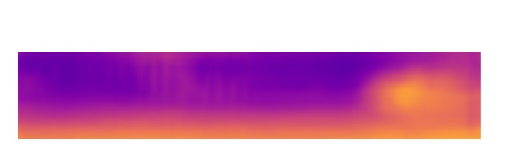
KITTI – Eigen et al. [NIPS 14]

Slide 29
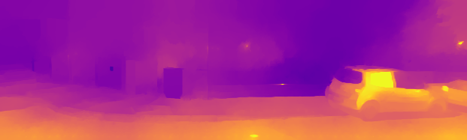
KITTI – Liu et al. [CVPR 14]

Slide 30
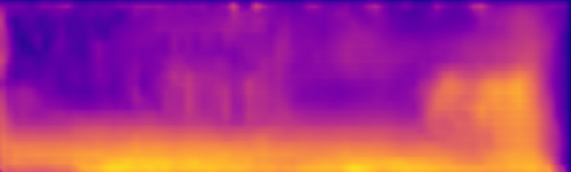
KITTI – Garg et al. [ECCV 16]

Slide 31
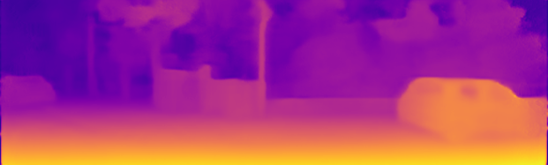
KITTI – Ours

Slide 32
KITTI – Input image

Slide 33
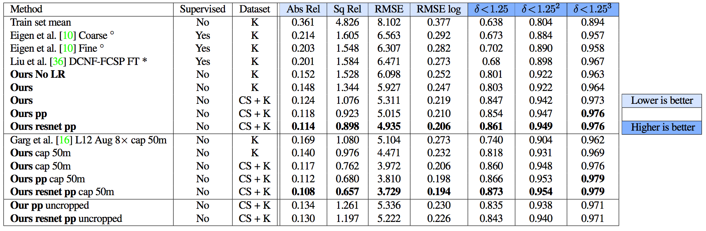
KITTI 2015
All variants of our model beat previous supervised methods

Slide 34
KITTI 2015
All variants of our model beat the previous unsupervised method

Slide 35
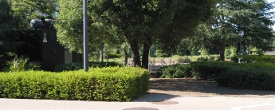
Make3D – Input image
Notes:
generalization

Slide 36
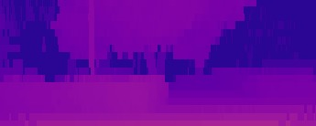
Make3D – Ground truth depth

Slide 37

Make3D – Karsch et al. [PAMI 14]

Slide 38
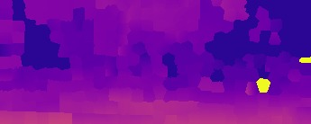
Make3D – Liu et al. [CVPR 14]

Slide 39

Make3D – Laina et al. [3DV 16]

Slide 40
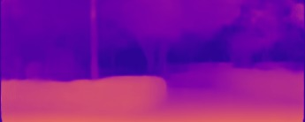
Make3D – Ours

Slide 41
Make3D – Input image

Slide 43
Challenges
Reprojection loss
Assumes lambertian world
More supervision?
Kuznietsov et al. [CVPR 17]
Need calibrated data
Synced and rectified
Less supervision?
Zhou et al. [CVPR 2017]

Slide 44
Conclusion
We can get depth from a single photograph
Self-supervision with stereo data
Cheap and scalable!
Accurate
Beats fully-supervised methods on KITTI!

Slide 45
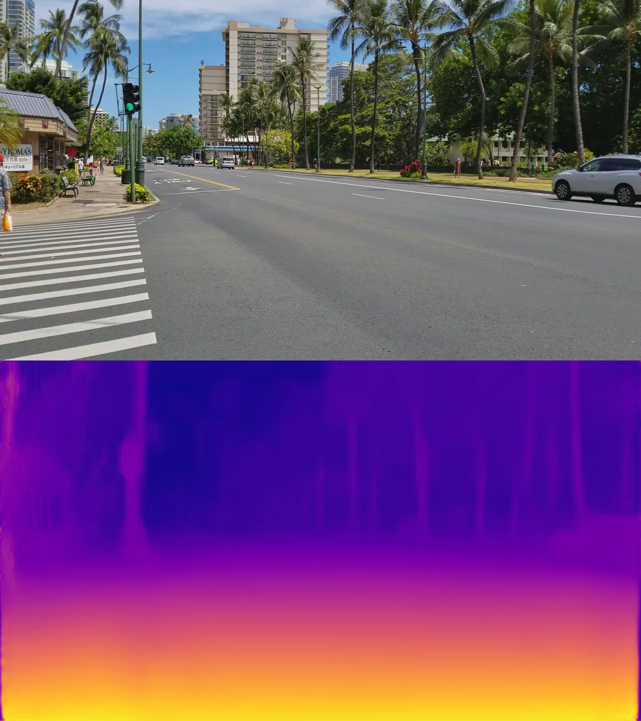
Thank you! See you at Poster 21
Training code
+
Models
+
Evaluation code
Available!
Search for monodepth

